Slide 1

Assignment 5
Luke Profio

Slide 2
Downstream Task 1: in-hospital mortality prediction [Logistic regression / Random Forest]
Our objective is to use only static admission features to predict mortality for each hospital stay.
Features include the age of the patient at admission, admission type (e.g. emergency vs. other), and gender.
A static method helps to establish a simple baseline, and shows how minimal demographics/admission context can already carry signal.

Slide 3
Downstream Task 1: Data Preparation
To prepare the data, we convert categorical columns (e.g. admission type, gender) into separate indicator variables.
The feature set is then generated, including this indicators along with age.
The data is then split into training and testing sets (80/20).
A one-hot encoding ensures models can handle non-numeric data.
Splitting into a training and test set helps prevent overfitting and provides an accurate performance estimate.

Slide 4
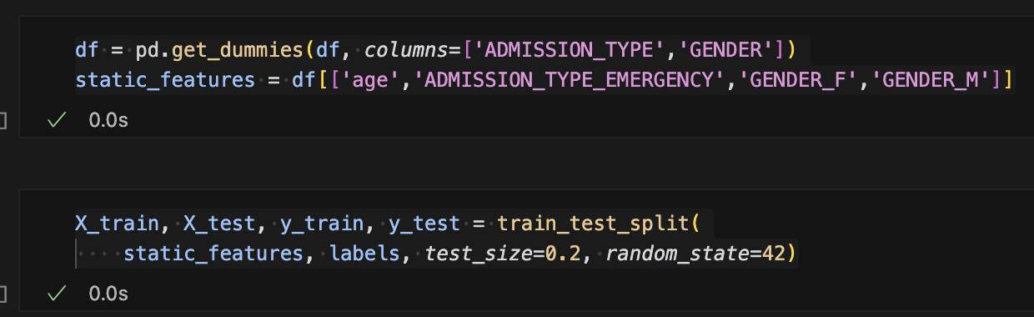
Downstream Task 1: Data Preparation

Slide 5
Downstream Task 1: Model training
Next up, we train two models: logistic regression and random forest.
Both models are evaluated on the testing set using ROC-AUC and overall accuracy.
It is ideal to compare a linear and non-linear ensemble model to see which better captures patterns in the static features.
Complementary metrics include AUC for ranking ability, and accuracy for overall correctness.
Both models have the same AUC, but logistic regression has a slightly improved accuracy, making it the model of choice.

Slide 6
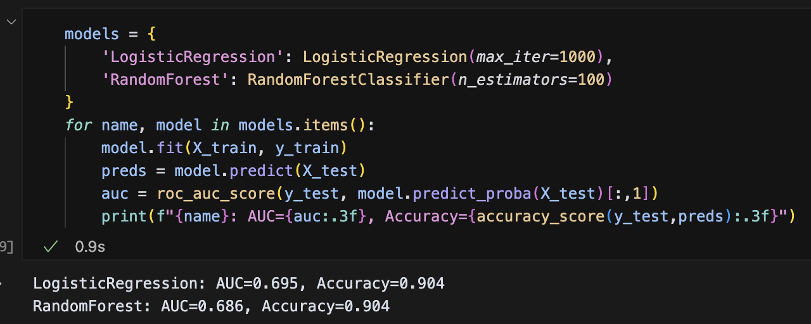
Downstream Task 1: Model training

Slide 7
Downstream Task 1: Model evaluation
We present the ROC-AUC and accuracy scores for both models.
This highlights which model performs better on each metric.
These benchmarks help guide decisions on whether more complex features or methods are needed.
As outlined earlier, since logistic regression and random forest have comparable AUC scores, logistic regression is the model of choice given its higher accuracy.

Slide 8
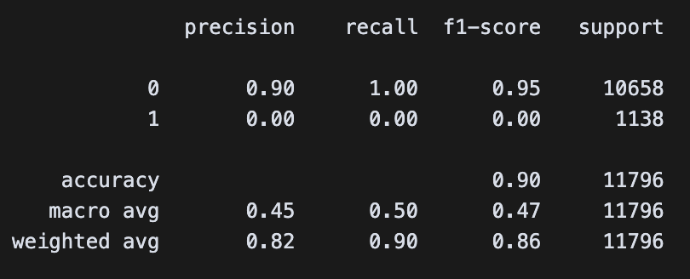
Downstream Task 1: Model evaluation

Slide 9
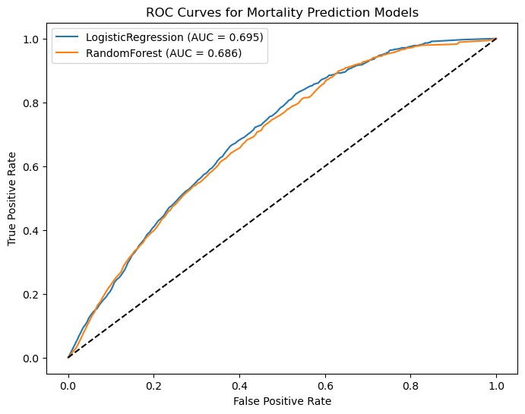
Downstream Task 1: Model evaluation

Slide 10
Downstream Task 1: evaluation
Additionally, we perform a grid search on random forest’s key configurations (e.g. number of trees, maximum depth).
We report on the best combination of parameters and detail the corresponding classification metrics (e.g. precision, recall).
Optimizing models improves generalization without over- or under-fitting.
Age and the emergency admission type are the most important features.

Slide 11
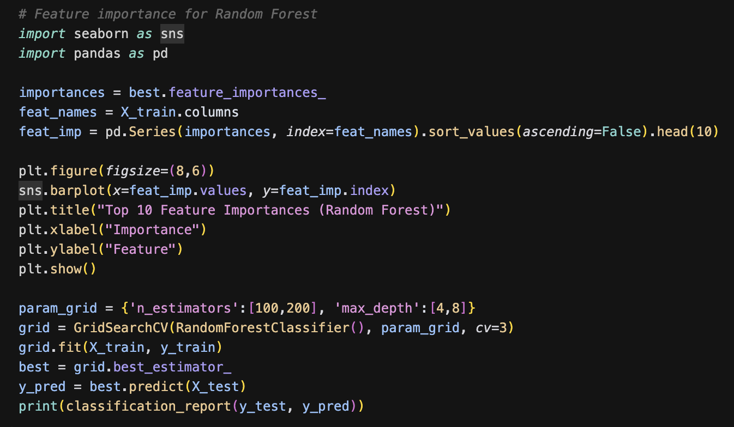
Downstream Task 1: evaluation

Slide 12
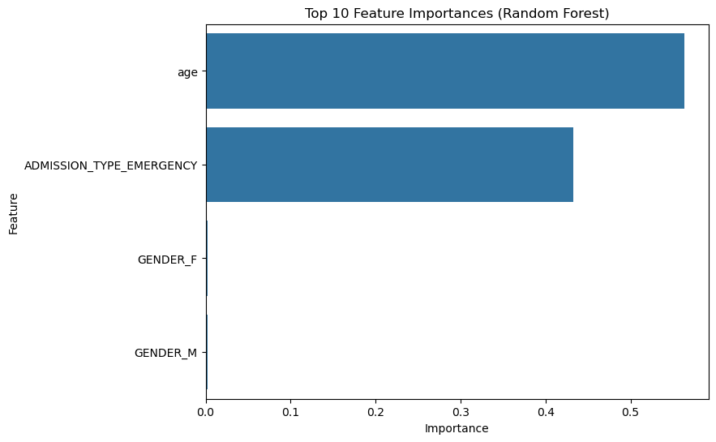
Downstream Task 1: evaluation

Slide 13
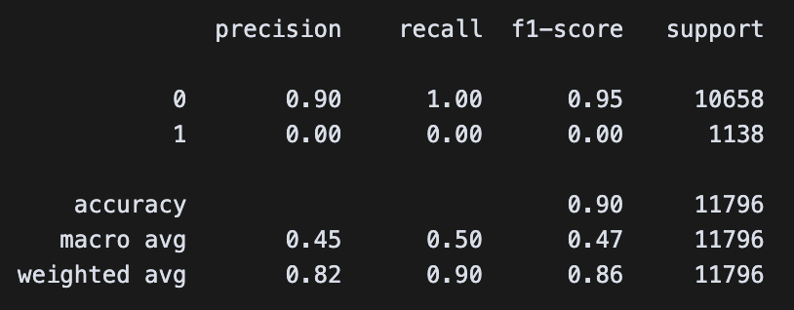
Downstream Task 1: evaluation

Slide 14
Downstream Task 2: Diagnosis category prediction [LSTM]
In this second downstream task, given the sequence of diagnosis-category IDs for a single hospital admission (in the order they occurred), we predict what the next diagnosis category will be.
Additionally, we demonstrate the application of sequence modeling (LSTM) to temporal EHR data.
This goes beyond static features, capturing the order and progression of diagnoses.

Slide 15
Downstream Task 2: data preparation
First, we map raw ICD-9 codes into 18 broad numeric categories.
All codes are grouped for a single admission into a time-ordered sequence.
Each admission’s sequence is split into “history” (all but last) as input and “last” as the target label.
Each input sequence is padded or truncated to a fixed length of 50.
Finally, we one-hot encode the 18 target categories.
The practice of binning reduces thousands of codes into a more manageable set.
Sequence slicing creates a standard next-step prediction format, while padding helps to ensure a uniform input size for the LSTM.

Slide 16
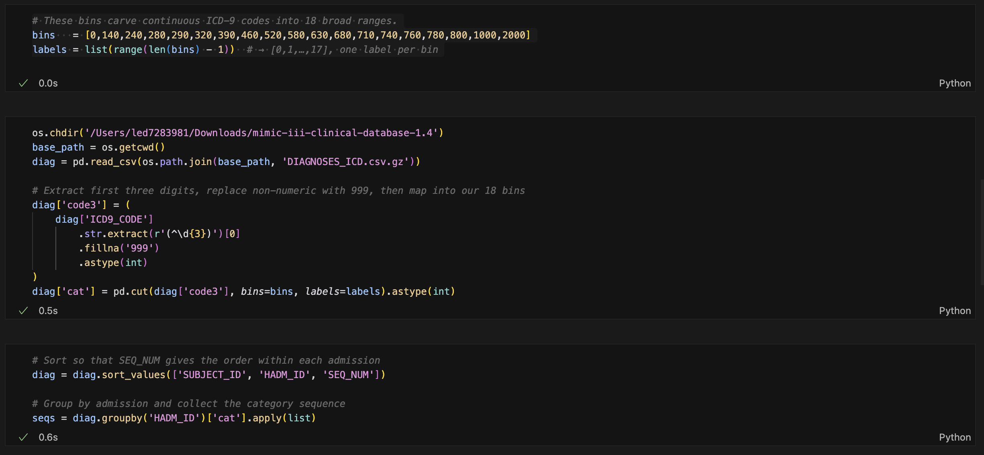
Downstream Task 2: data preparation

Slide 17
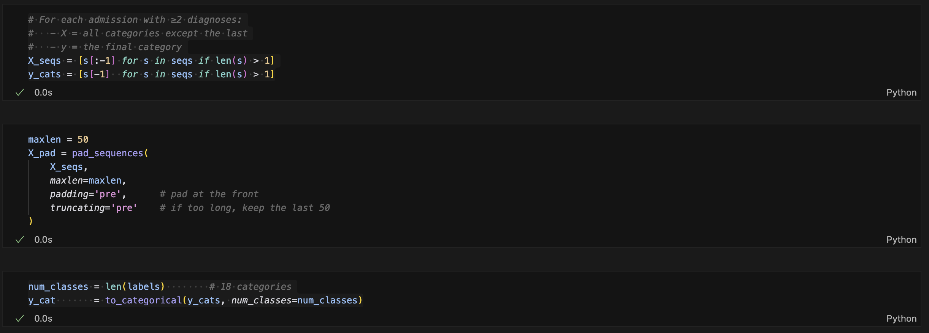
Downstream Task 2: data preparation

Slide 18
Downstream Task 2: Model architecture
We use an Embedding layer to learn 32-dimensional dense vectors for each category ID.
This is followed with a single LSTM layer of 64 units to process the sequence.
Finally, we utilize a Dense + softmax layer over 18 categories.
This embedding approach captures relationships between diagnosis categories.
LSTM is tailored for sequential dependencies, where order matters.
The softmax output gives a probability distribution for the next category.

Slide 19
Downstream Task 2: Training and validation
We split the data into a training and test set (80/20).
Within training, we reserve 10% for validation at each epoch.
We train for 10 epochs using categorical cross-entropy loss and the Adam optimizer.
Training vs. validation loss and accuracy are tracked each epoch.
Validation curves help in indicating over- or under-fitting early on.
Multiple epochs enable to model to refine its internal sequence representations.

Slide 20
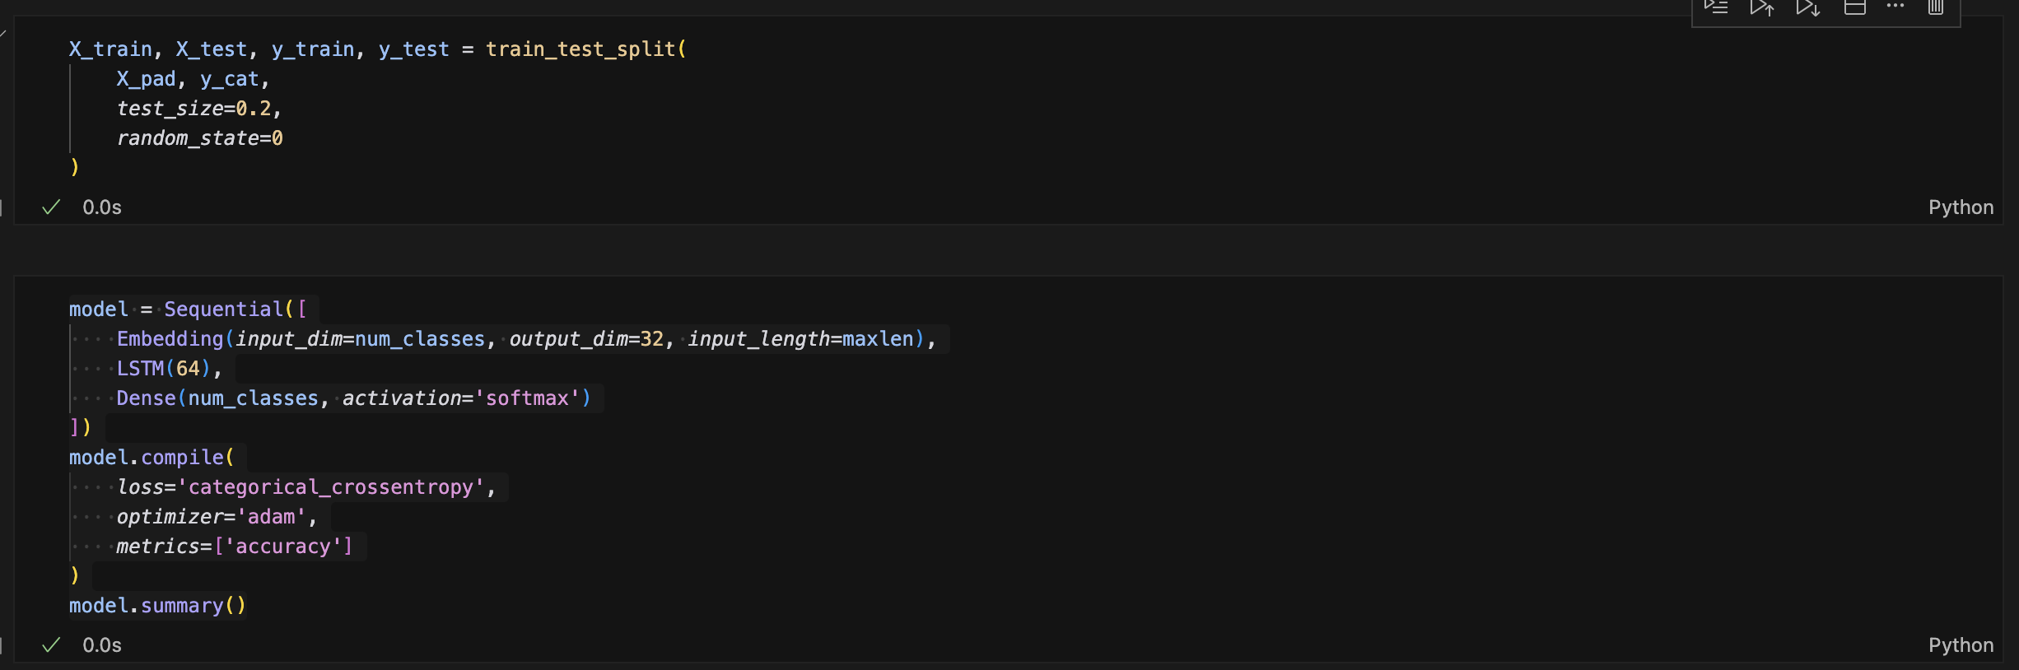
Downstream Task 2: Training and validation

Slide 21
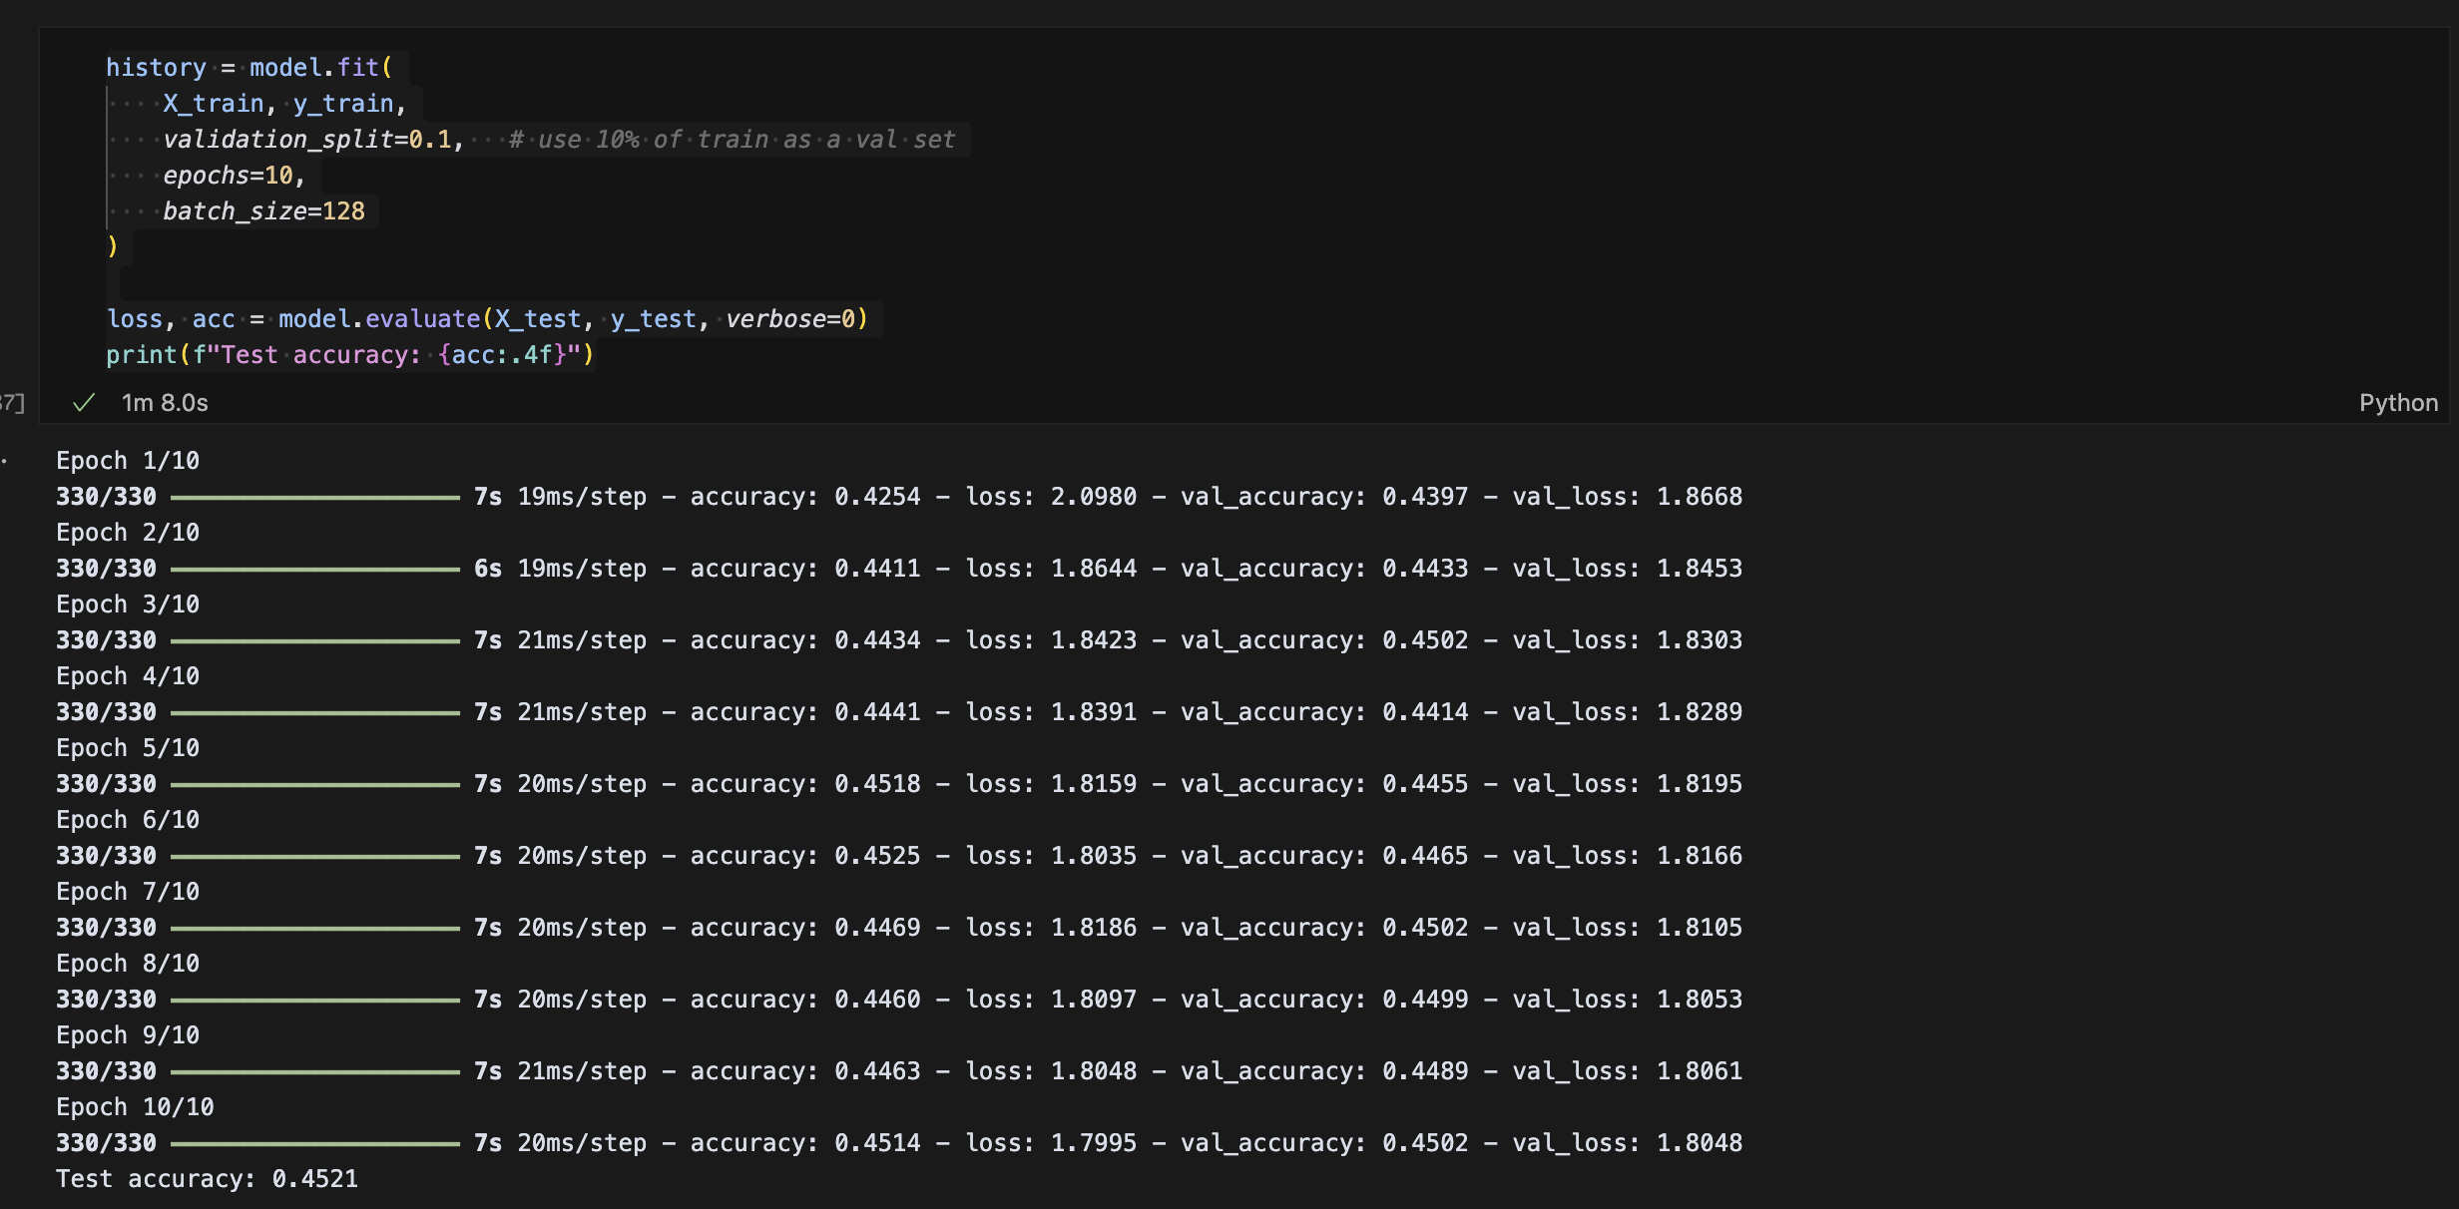
Downstream Task 2: Training and validation

Slide 22
Downstream Task 2: evaluation
As a part of evaluation, we measure final test accuracy on held-out admissions.
The training/validation loss and accuracy curves are plotted to assess convergence.
The distribution of true next categories in the test set is also plotted.
Finally, we generate a confusion matrix to see which categories are most frequently mis-predicted.
Test accuracy is the primary marker of overall performance.
Each of the curves plotted check model health (e.g. stable learning).
The distribution and confusion plots provide insights on where the model struggles.

Slide 23
Downstream Task 2: evaluation
Over time, the training and validation loss significantly decrease. Most of this decrease is attained by epoch 4.
Over epoch 1-10, accuracy increases by a little over 1%.
These evaluations indicate that core changes are required on the LSTM model (e.g. architecture, hyperparameters, data preparation), in order to increase accuracy further.

Slide 24
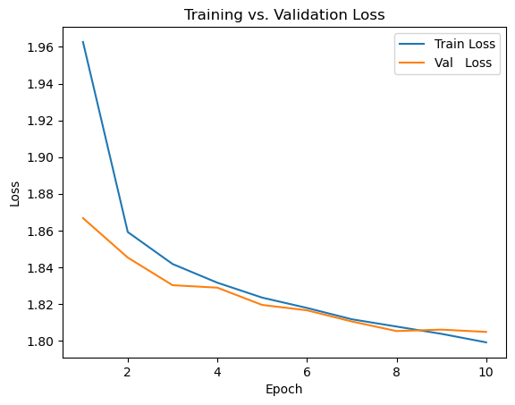
Downstream Task 2: evaluation

Slide 25
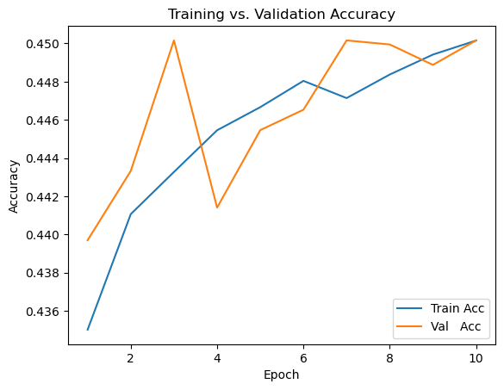
Downstream Task 2: evaluation

Slide 26
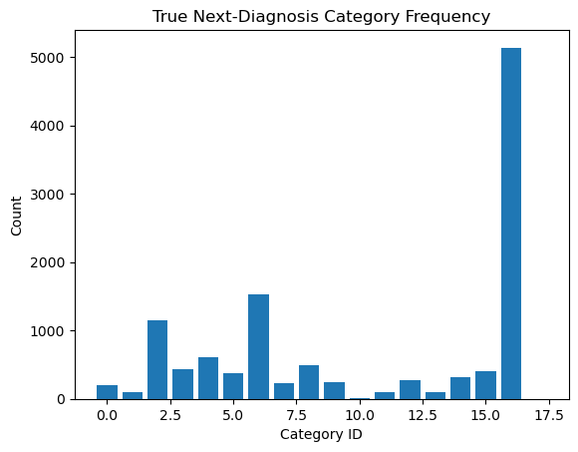
Downstream Task 2: evaluation

Slide 27
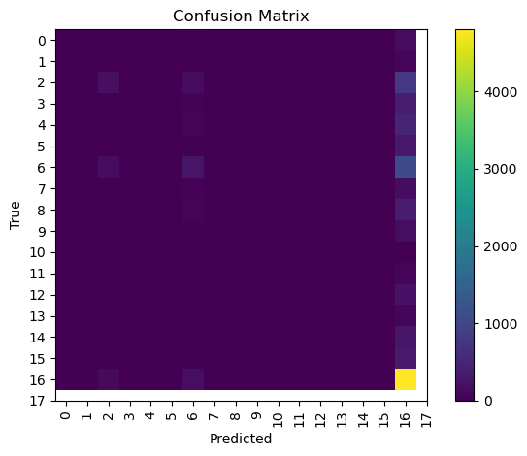
Downstream Task 2: evaluation

